Slide 1
Course overview
“Spring – first touch”
2011

Slide 2
Speaker’s Profile
Viktor Savonin, C.T.Co European IT solutions and services outsourcing company
  5+ years of software development experience
    Java developer
    Lead Java developer
    Java team Leader
  Master degree in Computer Science from TSI
  Currently
    Lead Java developer in C.T.Co company
    PHD student in TSI

Slide 3
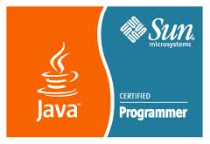
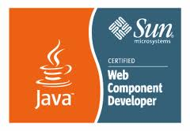
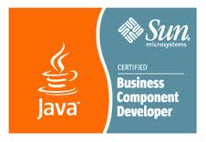

Speaker’s Profile
Sun Certified: SCJP, SCWCD, SCBCD

Slide 4
Why I am here?
    Share with you
      information about new technology
      my working experience
    Bring you a possibility
      to learn new things
      get real practical experience
Enjoy conversations and knowledge sharing

Slide 5

Let's get acquainted

Slide 6
Course format
Course length: 1 day (8 hours)
Course approach:
  presentations
  discussions
  practice
Level: Beginner / Intermediate

Slide 7

What course about

Slide 8

Do you know
Spring Framework
Do you write code using Spring

Slide 9
Course Objectives (1)
Overview of Java Enterprise Development

Slide 10
Course Objectives (2)
Understand core Spring concepts:
  Dependency Injection (DI)
  Inversion of Control (IoC)
  Basic Configuration

Slide 11
Course Objectives (3)
Describe how to develop application
with Spring:
  Organize database access
  Integration with web frameworks
  Aspect Oriented Programming
  Testing

Slide 12
Target Audience
Java developers
UI developers
DB developers
All best developers, who want to get knowledge and practical experience with Spring framework

Slide 13
Course Syllabus
Section 1: Java Enterprise Development

Slide 14
Course Syllabus
Section 1: Java Enterprise Development
Section 2: Dependency Injection

Slide 15
Course Syllabus
Section 1: Java Enterprise Development
Section 2: Dependency Injection
Section 3: Spring IoC container basics

Slide 16
Course Syllabus
Section 1: Java Enterprise Development
Section 2: Dependency Injection
Section 3: Spring IoC container basics
Section 4: Spring configuration styles

Slide 17
Course Syllabus
Section 1: Java Enterprise Development
Section 2: Dependency Injection
Section 3: Spring IoC container basics
Section 4: Spring configuration styles
Section 5: Spring overview

Slide 18
Course Syllabus
Section 1: Java Enterprise Development
Section 2: Dependency Injection
Section 3: Spring IoC container basics
Section 4: Spring configuration styles
Section 5: Spring overview
Section 6: Build application with Spring

Slide 19
Course Syllabus
Section 1: Java Enterprise Development
Section 2: Dependency Injection
Section 3: Spring IoC container basics
Section 4: Spring configuration styles
Section 5: Spring overview
Section 6: Build application with Spring
Practice Practice Practice ☺

Slide 20
Course Syllabus future sections
Section 7: Aspect Oriented Programming (AOP) with Spring
Section 8: Testing with Spring

Slide 21

Any Questions?

